Slide 1
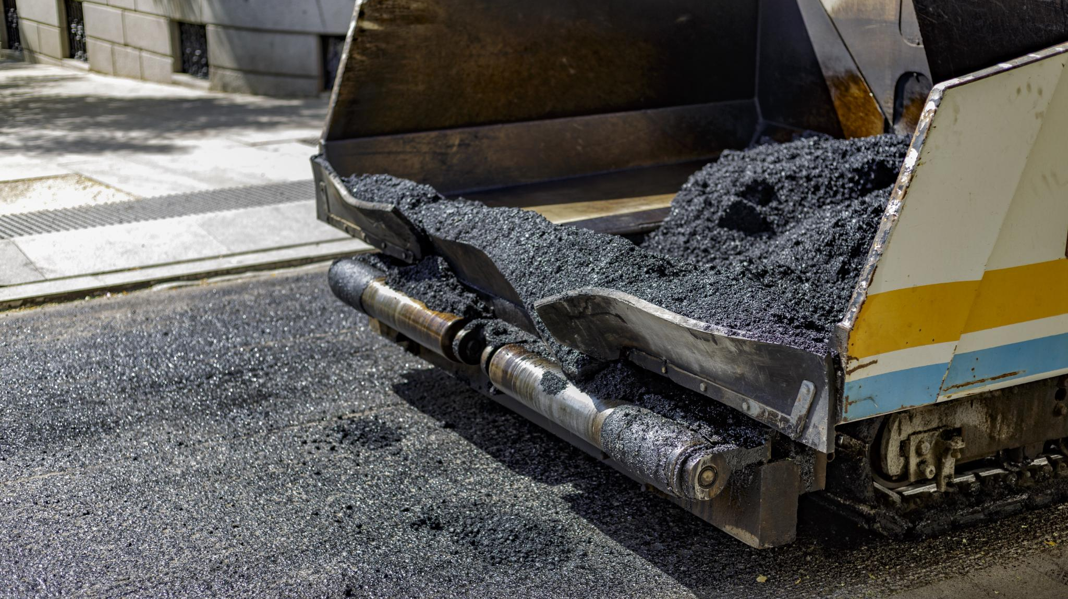
Innovations & Practices in Recycled Asphalt Pavement.
Sustainable roads for a better future
Notes:
In this presentation, we will delve into the world of Recycled Asphalt Pavement (RAP) and explore its benefits, lifecycle, and recycling process.

Slide 2
What is Recycled Asphalt Pavement (RAP)?
Recycled Asphalt Pavement (RAP) refers to the process of reclaiming and reusing old asphalt materials from roads, highways, and parking lots to create new asphalt mixes. The goal is to reduce the amount of new raw materials needed for asphalt production and to minimize waste, making the process more sustainable and cost-effective.
Notes:
Recycled Asphalt Pavement (RAP) is a material derived from old asphalt materials that have been removed from a pavement surface or waste materials from asphalt plant operations. It is reprocessed and used in new asphalt mixes. The basic concept of RAP is to reuse and recycle the materials from old asphalt pavement.

Slide 3
Introduction to Asphalt Pavement Recycling
Brief History and Evolution
Asphalt recycling has been around since the early 1900s, but it was not until the 1970s that it started to gain popularity due to an energy crisis which led to a significant rise in oil prices. The Arab oil embargo of 1970 put the United States economy back. This caused fuel shortages, rising oil prices, and long lines at gas stations due to limited supply. Due to this crisis RAP was introduced to help lower construction costs and preserve oil and other natural resources.
Although the use of RAP was not widely accepted when it was first introduced. Today, it is a common practice in the asphalt industry leading to widespread implementation in various construction projects and is an important part of sustainable construction.
Notes:
In this section, we will discuss the basic concept of Recycled Asphalt Pavement (RAP), its brief history and evolution. We will also highlight the importance of recycling asphalt and the environmental and economic benefits it provides.

Slide 4
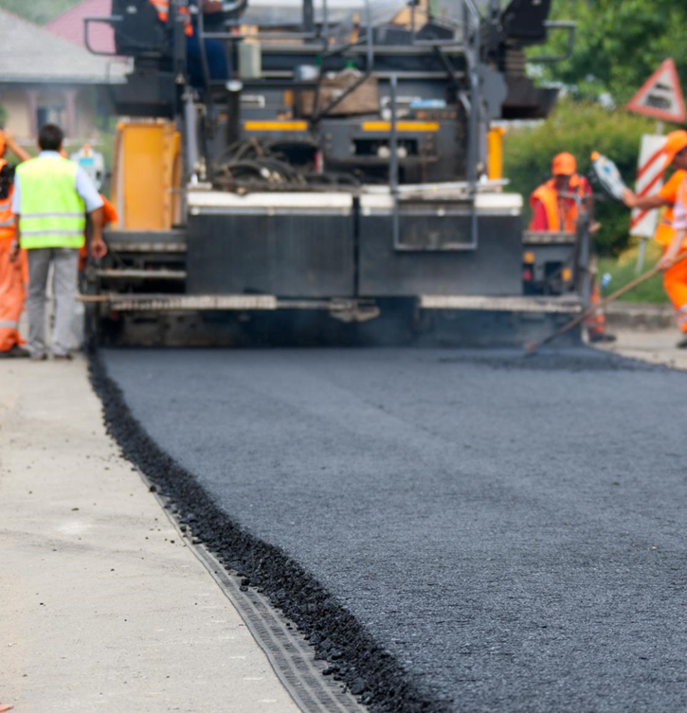
The Importance of Recycling Asphalt
As of 2018 about 95% of all RAP was reused in paving projects across the country. Recycling asphalt helps to reduce the environmental impact of asphalt production, reduce costs, and conserve natural resources. It also helps to create a sustainable construction industry.

Slide 5
Environmental Benefits
Recycled Asphalt Pavement (RAP) offers several environmental benefits:
Waste Reduction
Conservation of Natural Resources
Lower Emissions
Energy Savings
These benefits make RAP a sustainable and environmentally friendly option for road construction and maintenance.

Slide 6
Economic Benefits
Recycled Asphalt Pavement (RAP) offers several economic benefits:
Cost Savings
Efficient Resource Use
Quality Standards
Lower Material Costs
Notes:
Cost savings – reduces materials costs
Efficient resource use – new modern milling techniques minimize harvesting waste
Better quality control with new processing methods
Lower material costs for virgin aggregates and asphalt

Slide 7
Lifecycle and Recycling Process of Recycled Asphalt Pavement
Asphalt pavement has a lifespan of 10 –20 years.
When it deteriorates, it is removed and processed into Reclaimed Asphalt Pavement (RAP).
RAP is then mixed with new materials to create new asphalt mixes.
The recycling process conserves resources and reduces waste significantly.
RAP can be reused multiple times but may degrade in quality over time.
Notes:
The lifecycle of asphalt pavement begins with its initial installation, lasting between 10 to 20 years. Once the asphalt deteriorates, it can be reclaimed and processed into Reclaimed Asphalt Pavement (RAP). This process not only conserves natural resources but also significantly reduces waste. While RAP can be reused multiple times, it's essential to monitor its quality as it may degrade over time.

Slide 8
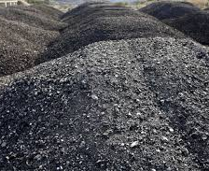
Construction and Usage of Reclaimed Asphalt Pavement Asphalt Paving Base or Subbase Material Erosion Control and Landscaping
Notes:
Rap replacement is typically 15 – 50% in hot mix asphalt, FDR, CIR, etc
Rap in base course – good compaction properties and increases structural integrity
Erosion control and landscaping – easy to compact and can stabilize areas prone to erosion.

Slide 9
End-of-life considerations
Continual Reuse
Material Degradation
Limited Disposal Options
Innovation in Reuse
Notes:
Rap can be recycled many times in new asphalt mixes however there are limits to the # of times it can be reused without degrading the quality.
Material degradation the aggregate and binder deteriorate leading to workability, adhesion and long term performance
Limited disposal – use it in landscaping or not paving applications instead of putting in landfill
Innovation – research and innovation are on going to explore new uses – possibly even incorporating into different industries

Slide 10
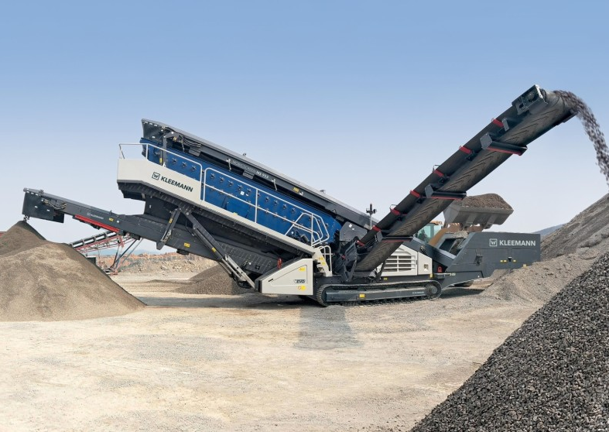
When considering a RAP source
Appearance:
Rich color or medium gray, dull grey to white, lots of crack seal
Good, OK, Bad/Ugly
Smell:
distinct smell, strong, used motor oil, burnt or dirty
Touch:
squeeze, firmness/softness, how much residual asphalt on your hand.

Slide 11
Recycling Process
Reprocessing and Mixing with New Materials
The collected RAP materials are reprocessed and mixed with new aggregates and asphalt binders to produce a new mix.
Quality Control and Testing
The final step in the recycling process is quality control and testing. The new mix is tested to ensure that it meets specifications for strength, durability, and performance.
Notes:
The recycling process involves the collection and milling of old asphalt, crushing and screening, reprocessing and mixing with new materials, and quality control and testing. The collected RAP materials are processed and mixed with new aggregates and asphalt binders to produce a new mix. The quality of the new mix is tested to ensure that it meets specifications.

Slide 12
Asphalt Analyzer for Extraction Process
The asphalt analyzer is used primarily to extract and recover the rap asphalt from the RAP using an extraction process. The rap asphalt is then further tested for asphalt binder physical properties.
It can also be used to measure the asphalt content of a sample without the necessity of binder correction samples.
Notes:
The Infratest Asphalt Analyzer is a device that is used to determine the asphalt content of a sample. It works by using a method called infrared spectroscopy, which involves shining an infrared beam onto a sample and analyzing the reflected light. This allows the analyzer to determine the asphalt content of the sample. The asphalt content of a sample is an important factor in determining the quality and usability of the sample.

Slide 13
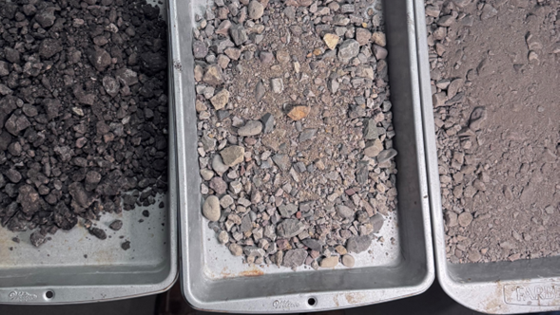
The testing stages
The left pan is newly sampled RAP
The middle pan is the RAP sample after the recovery of asphalt using the Asphalt Analyzer
The right pan is the RAP sample tested in the binder ignition oven.

Slide 14
Equipment used to determine physical properties of asphalt
Direct Shear Rheometer (DSR) determines the shear stress.
DSR – original (virgin asphalt)
DSR – RTFO (virgin & rap asphalt)
G*/Sin ∆ - kPa
Notes:
Dynamic Shear Rheometer (DSR) is used to determine how the binder behaves under different WARM temperatures and stresses. Measures Both the stiffness and elasticity.

Slide 15
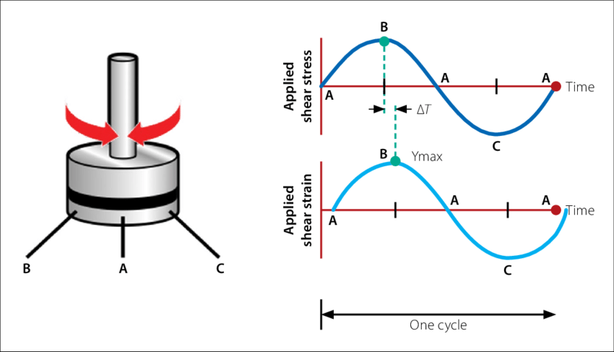
Notes:
Different diameters of plates – 25 mm and 8 mm – 25 mm for Original and RTFO, the 8 is used after the pav test (intermediate)
G star sign delta
Original G star minimum 1 kpa
RTFO G star minimum 2.2 kpa
PAV G star maximum 5000

Slide 16
Equipment used to determine physical properties of asphalt
Bending Beam Rheometer determines the low temperature properties of the binder.

Slide 17
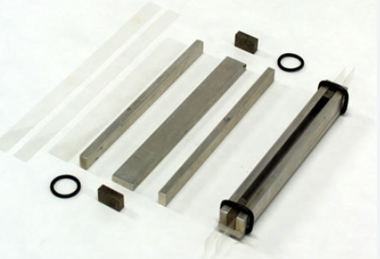
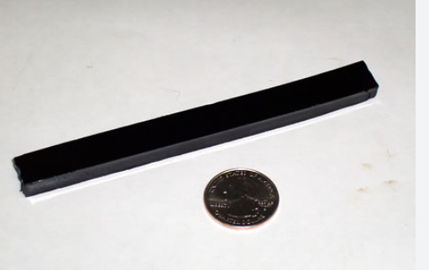
BBR samples & test
Notes:
Bending Beam Rheometer (BBR) is used to measure the low-temperature properties of asphalt binders. It measures stiffness and the ability to resist cracking in cold temps by applying a small load. BBR test adds 10 degree C for a safety factor.
Stiffness is MPa, the M value is unitless
980 milli newtons or 100 grams force over 60 seconds
Passing rate is less than 300 Mpa for stiffness
Passing rate is greater than 0.300 for m value

Slide 18
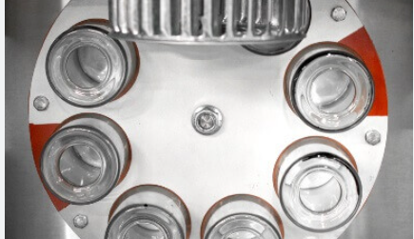
Equipment used to determine physical properties of asphalt
Rolling Thin Film Oven (RTFO) is used to simulate short term aging.
After the sample is aged it is run back thru the DSR test.
The RTFO DSR is used in RAP Blending calculations.
Notes:
It exposes the binder to heat and air while rolled in a rotating bottle. It replicates the effects of aging when the asphalt is mixed and laid down.
Minimum 2.2 kPa

Slide 19
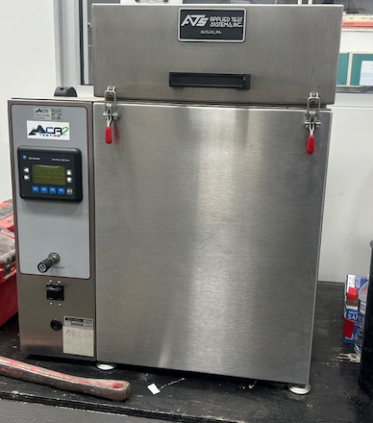
Equipment used to determine physical properties of asphalt
Pressure Aging Vessel (PAV) is used to simulate the long term aging process that occurs over several years of service.
This test is only used on virgin asphalt samples.
After this aging process the sample is moved to a degassing oven to remove the entrapped air.
Notes:
This mimics the effects of oxidation and environmental exposure. It is a measure of the long term durability. The rap asphalt has already been aged and oxidized – no sense further oxidizing it.

Slide 20
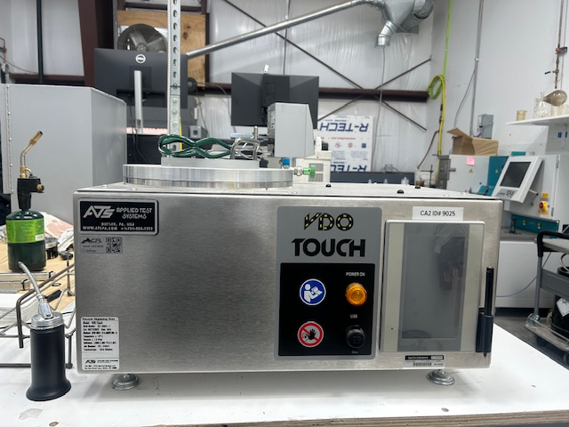
Equipment used to determine physical properties of asphalt
Degassing Oven – used to remove the entrapped air from the PAV sample.
After this aging process the sample is retested in the DSR.
The DSR results of this test determine the intermediate PG grade temperatures.
Notes:
Rap process – extract, DSR RTFO, DSR (RTFO aged as if PAV aged), BBR
PAV requirements but not PAV machine

Slide 21
Final Virgin Asphalt Report Analysis
Notes:
Samples are classified using AASHTO M320 – 58-28, 64-22, 76-22, etc. However, for blending purposes we need the “true grade”. RTFO results normally govern because it give a more realistic picture of the binders performance immediately after construction and during the initial service period.

Slide 22
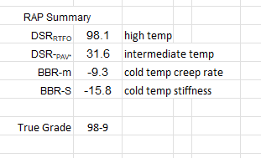
Final RAP Report Analysis
Sample 1 - typical
Sample 2 - bad
Notes:
The BBR m creep rate indicates how quickly the binder can relax stress under sustained loading – PG Spec is greater than 0.300 @ 60 seconds.

Slide 23
RAP/Virgin Asphalt Blend Analysis
Rap sample 1
Notes:
Mathematical blend

Slide 24
Challenges & Solutions
Binder Aging and Performance
Challenge: Asphalt binder in RAP can become oxidized and brittle over time, which can reduce the performance of the final mixture, especially under extreme temperatures.
Solution:
Rejuvenators: Rejuvenators or softening agents can be added to RAP to restore some of the lost binder properties, improving flexibility and performance.
Proper Mix Design: account for the aging of the binder by adjusting the PG Grade and amount of virgin binder to ensure the final mix meets the desired performance criteria, particularly for higher traffic or harsh environmental conditions.
Notes:
Rejuvenators specifically designed to restore physical and chemical properties (original state)
Softening agents primarily reduce viscosity making them easier to work with – will help physical but not chemical properties.

Slide 25
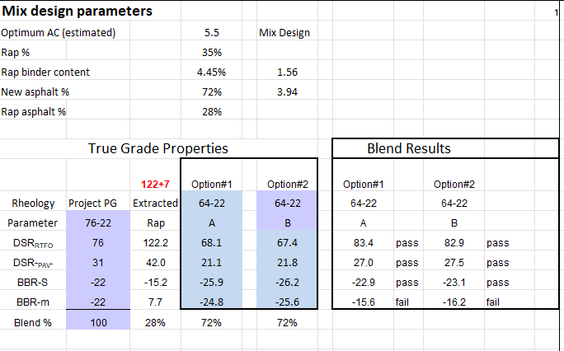
Challenges & Solutions
True grade with this blend is 83-16
Will try again with rejuvenator.

Slide 26
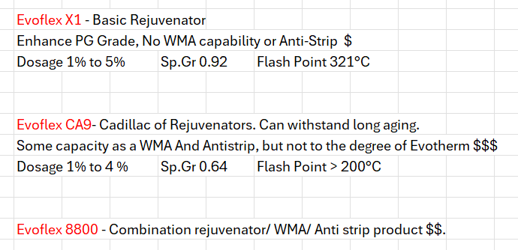
Types of Rejuvenator

Slide 27
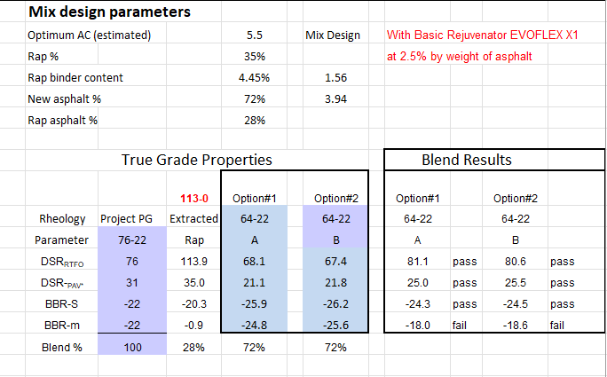
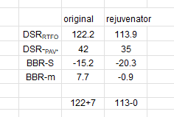
Challenges & Solutions
Same sample with 2.5% rejuvenator added. – still failed but made progress.

Slide 28
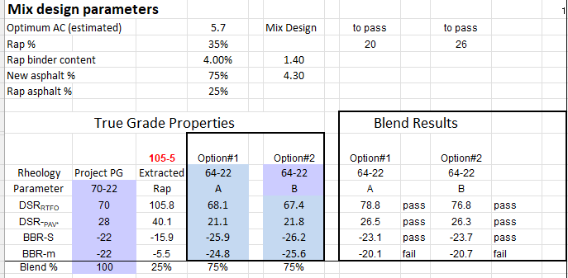
Challenges & Solutions – typical rap

Slide 29
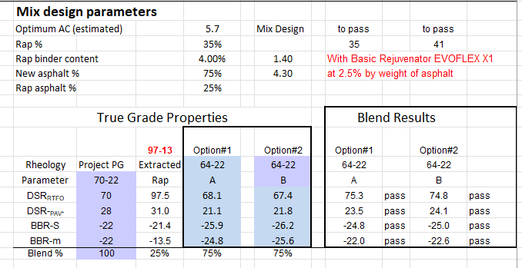
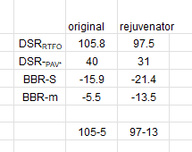
Challenges & Solutions – Typical Rap with Rujuvenator
True grade – 75-22
PG grade 70-22

Slide 30
Challenges & Solutions
Contamination of RAP
Challenge: RAP can sometimes be contaminated with foreign materials such as soil, debris, metal, crack seal or even other types of asphalt mixtures. Contaminants can compromise the structural integrity and longevity of the pavement.
Solution:
Preprocessing and Screening: Prior to using RAP in new mixes, it should be carefully processed, screened, and cleaned to remove contaminants.
Source Control: Ensuring that RAP is sourced from controlled, clean environments (e.g., well-maintained roads) can reduce the likelihood of contamination.
Use the RAP in a different application such as base course or FDR.

Slide 31
How do you know ??
How do you know the rap sample collected and tested is the same as represented in the mix design?
Collect representative sample of rap
Test asphalt content
Test gradation
Test Gmm
These 3 test parameters will allow comparison to the mix design data.
Worst case, extract and grade the rap.

Slide 32
Technologies and Techniques in Asphalt Recycling
Other Uses for RAP
Hot In-Place Recycling (HIPR)
Cold In-Place Recycling (CIR)
Full-Depth Reclamation (FDR)
Notes:
Hot In-Place Recycling (HIPR), Cold In-Place Recycling (CIR), and Full-Depth Reclamation (FDR) are all technologies and techniques used in the asphalt recycling process.

Slide 33
The Processes & Benefits of Repaving Methods with RAP
HIPR Process- This process involves heating the asphalt to over 300 degrees Fahrenheit, after it is heated the surface is then scarified & milled and then mixed in with new asphalt or a rejuvenating agent, lastly it is laid down and compacted.
HIPR Benefits- This Method can extend the life of a road by 7 – 15 years, it also save up to 40% on project costs, reduces the time to a couple hours or less which also improves safety for everyone involved.

Slide 34
The Processes & Benefits of Repaving Methods with RAP
CIR Process- This process involves a train of equipment that crushes the existing roadway, adds new liquid asphalt and paves simultaneously the mixture is then cured which can take several days or even weeks.
CIR Benefits- This method improves the structural Integrity, reduces traffic distribution as well as construction time & costs and lastly it conserves resources & minimizes environmental impact.

Slide 35
The Processes & Benefits of Repaving Methods with RAP
FDR Process- This Process takes cold in-place recycling to the next level by grinding up the old pavement and using it as a stronger foundation for the new roadway. The FDR is used to fix pavement failures cause by degradation, as well as cracking, rutting ,and potholes.
FDR Benefits- This method has many of the same benefits as the previous two, it is cost saving, environmentally friendly, as well as improves pavements performance.

Slide 36
Lessons learned & best practices
Material Quality Variability: RAP can vary significantly in quality due to different sources and ages. Conducting thorough assessments of the material’s properties is crucial for successful integration.
Monitoring Environmental Impact: The use of RAP can reduce environmental impact, but it's important to monitor emissions and energy use during production to maximize benefits.
Performance Testing: Implementing performance testing, such as the Superpave or Hamburg wheel tracking tests, helps predict how the mixture will perform under traffic and environmental conditions.

Slide 37
Lessons learned & best practices
Proper Processing, Storage and Handling: Store RAP in a manner that prevents contamination and degradation. Use proper handling techniques to minimize loss of material quality.
By learning from past experiences and adhering to these best practices, the effective use of RAP can lead to more sustainable and cost-effective road construction solutions.

Slide 38
Q&A and Interactive Discussion
Open the floor for questions and discussion.
Notes:
This slide is an opportunity for the audience to ask questions and engage in a dialogue about specific interests or concerns. By opening the floor for discussion, we can address any lingering questions or uncertainties and ensure that the audience walks away with a comprehensive understanding of the content presented.

